Slide 1
Spatial Proteomics Analysis
Olivia Rippee
Final Presentation
May 6, 2024

Slide 2
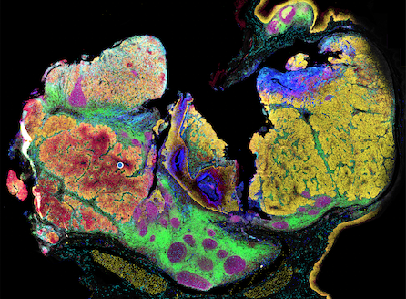
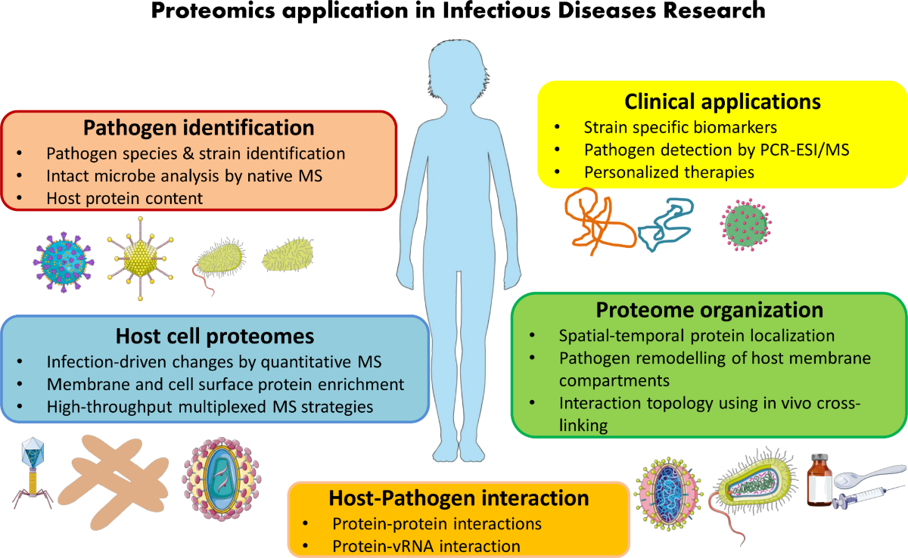
Purpose of Spatial Proteomics
Proteomics
study of the interactions, function, composition, and structures of proteins and their cellular activities
Unlike DNA/chromosome, the proteome changes depending on the tissue type, cell type, and cell activity
Spatial proteomics
Quantify and locate proteins within a cell and subcellular structures (organelles)
Better understanding of protein function
Health Applications
Locate problems in protein transport associated with diseases
Integrate knowledge of fundamental biology with disease

Slide 3
Spatial Proteomics Tools and Datasets in R
pRoloc/pRolocGUI/pRolocdata package
https://www.bioconductor.org/packages/release/bioc/html/pRoloc.html
https://bioconductor.org/packages/release/bioc/vignettes/pRolocGUI/inst/doc/pRolocGUI.html
RforProteomics package
https://bioconductor.org/packages/release/data/experiment/html/RforProteomics.html
Data sets: hyperLOPIT2015, hyperLOPIT2015ms3r1, hyperLOPIT2015ms3r2, lopitdcU2OS2018 (Msnbase package)

Slide 4
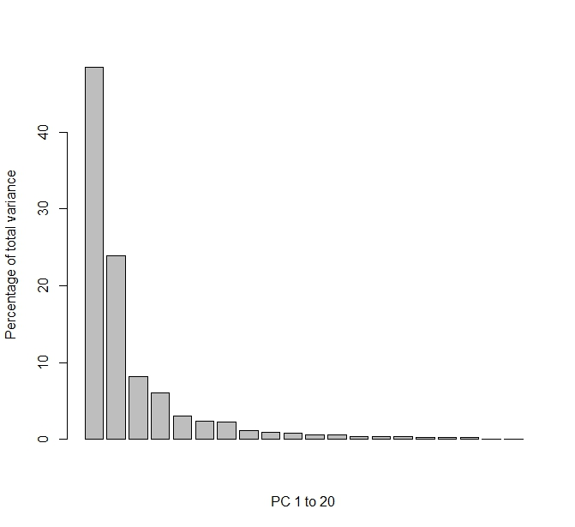
Dimension Reduction - PCA
First variable accounts for ~50% of variability
Second variable accounts for an additional ~25%
Third variable accounts for ~10%
~85% of variation accounted for by 3 variables. Simpler model!

Slide 5
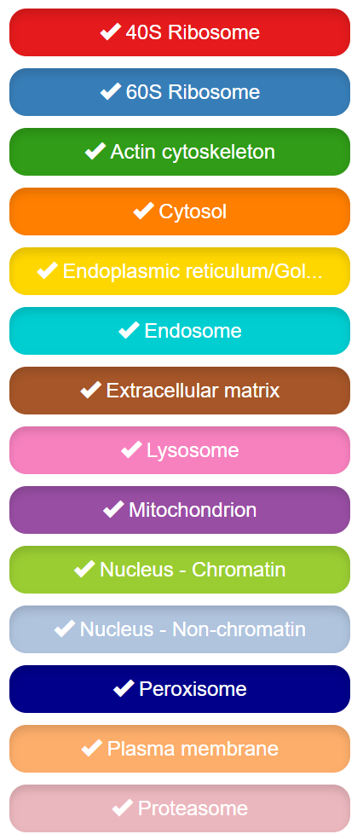
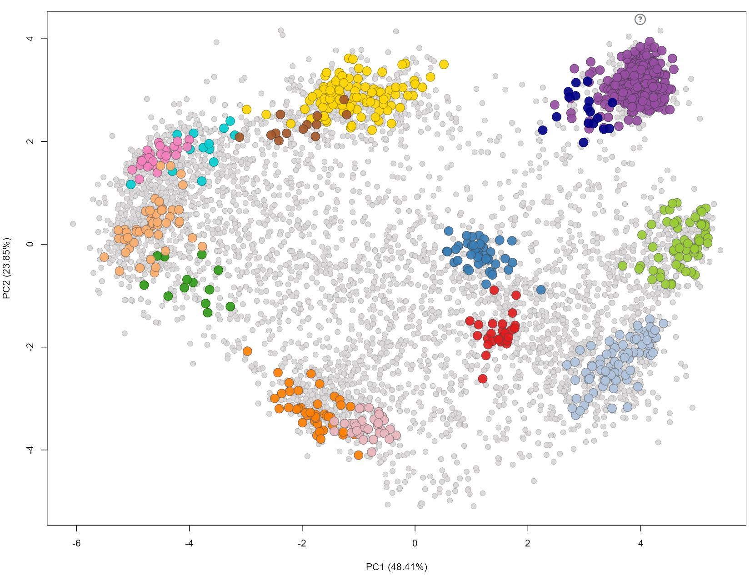
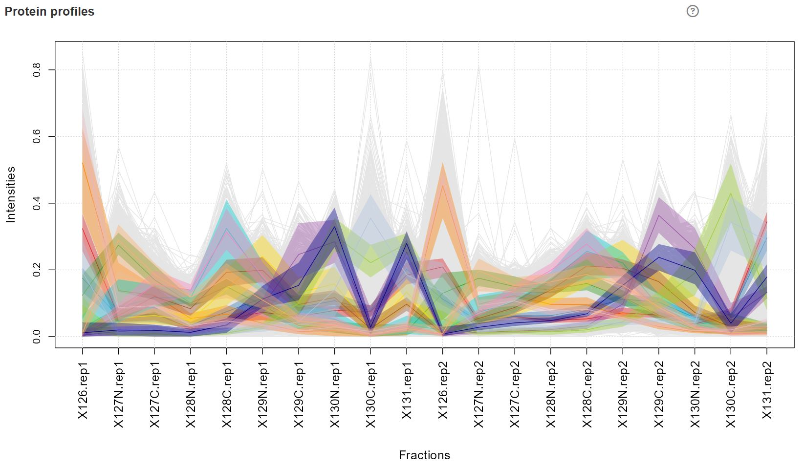
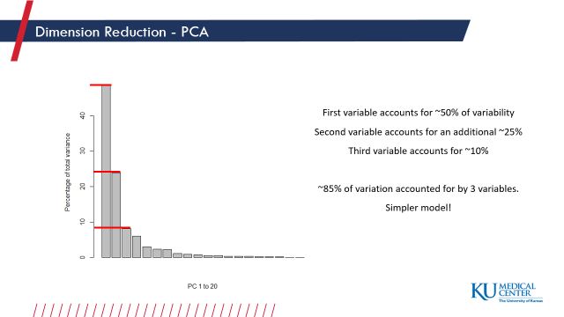
Spatial Map and Profile Plot

Slide 6
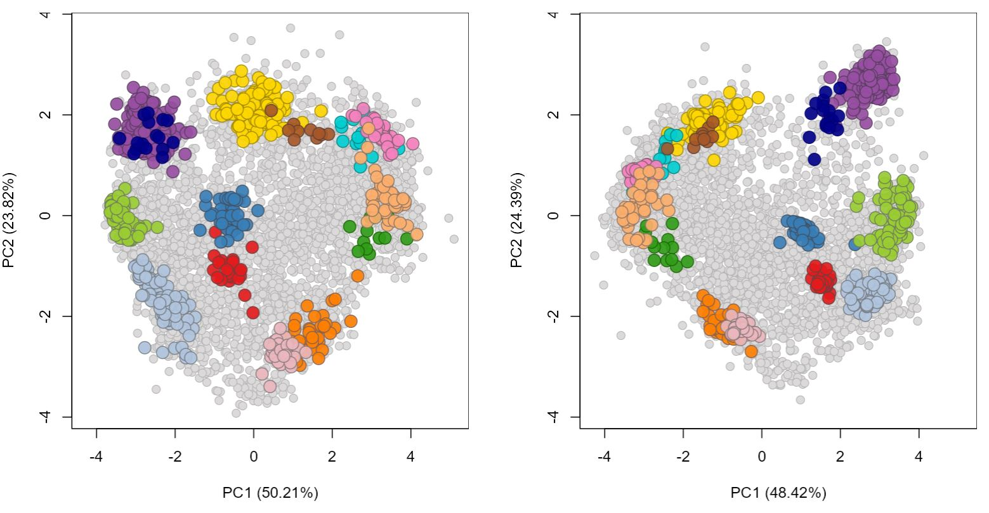
Comparison: Spatial Maps

Slide 7
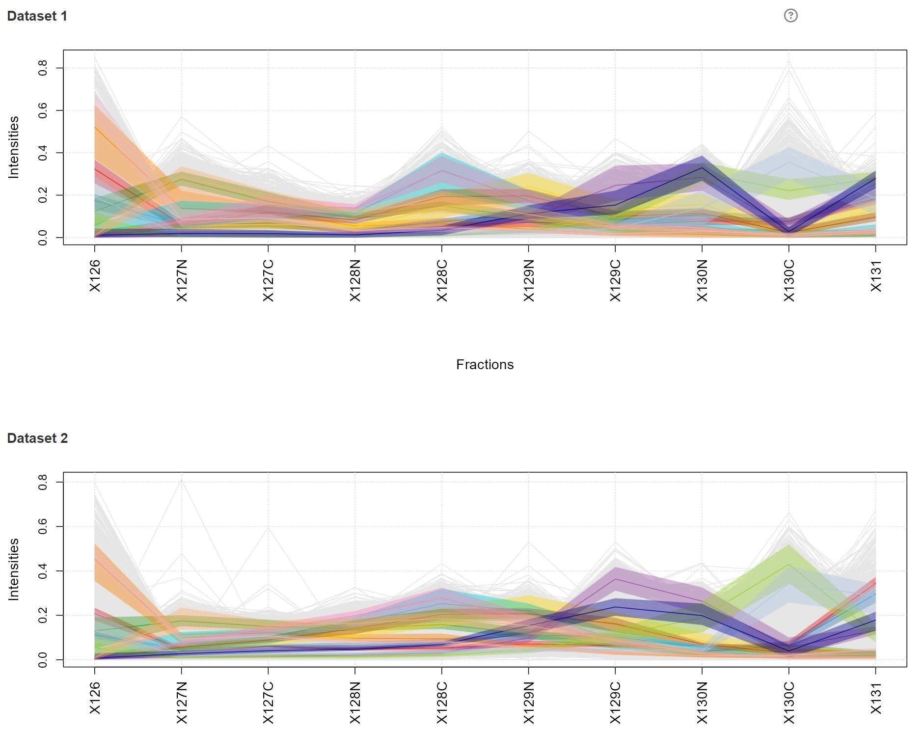
Comparison: Profile Plots

Slide 8
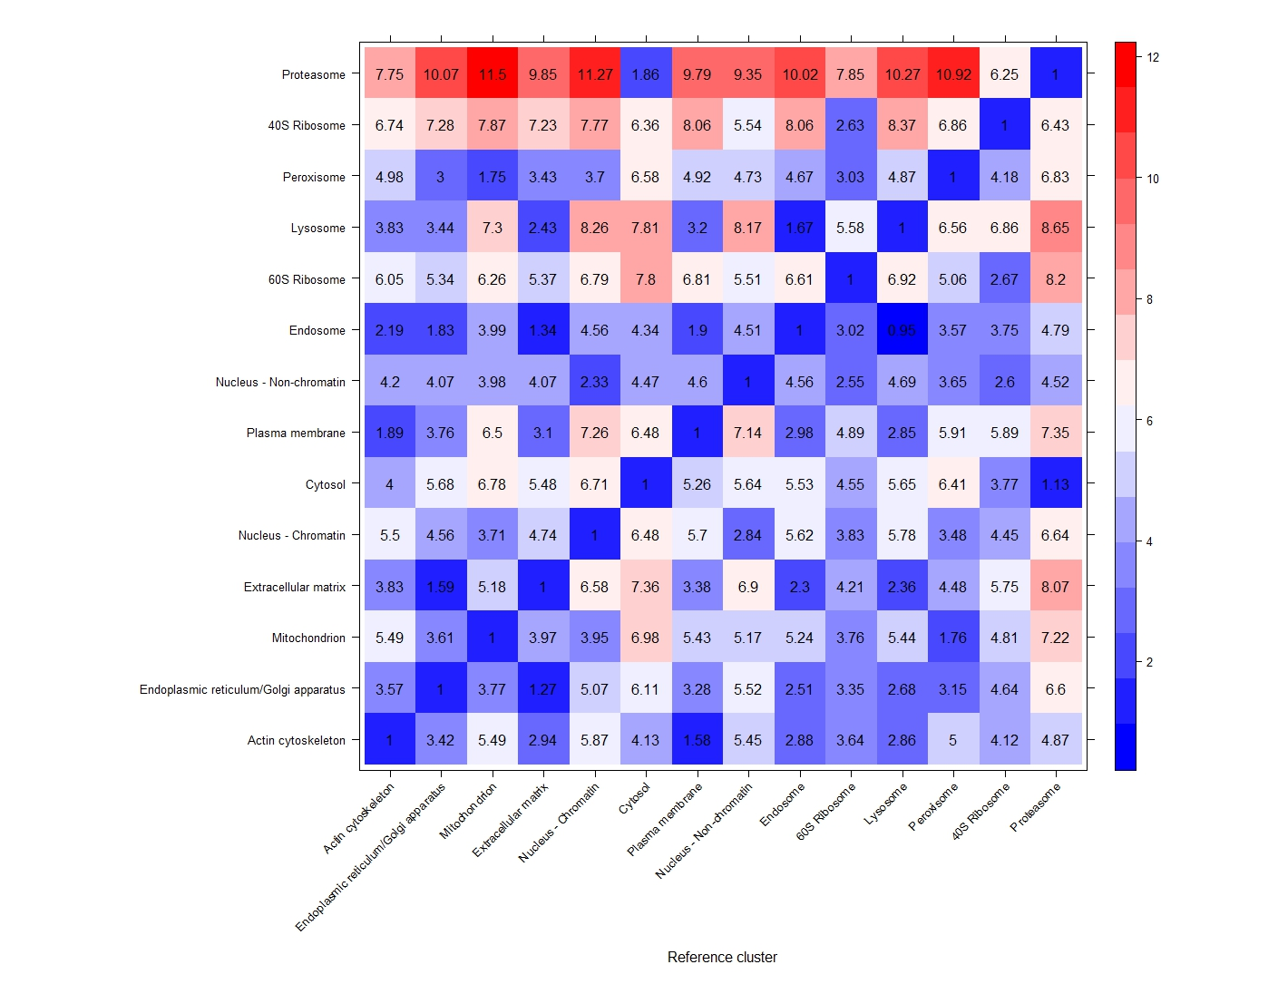
Location Correlation Heatmap

Slide 9
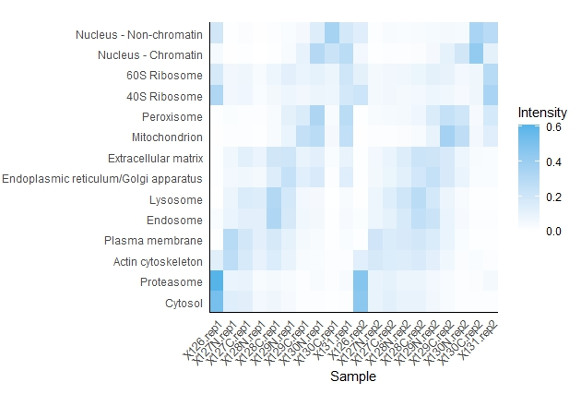
Protein vs Location Heatmap

Slide 10
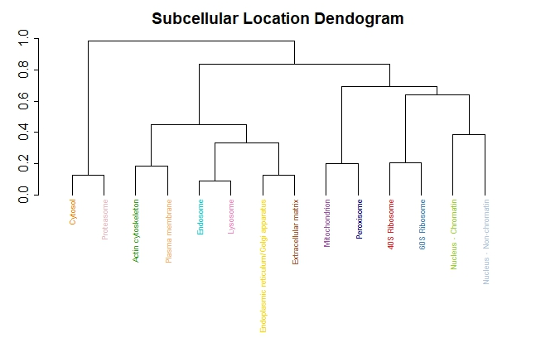
Subcellular Location Hierarchical Clustering

Slide 11
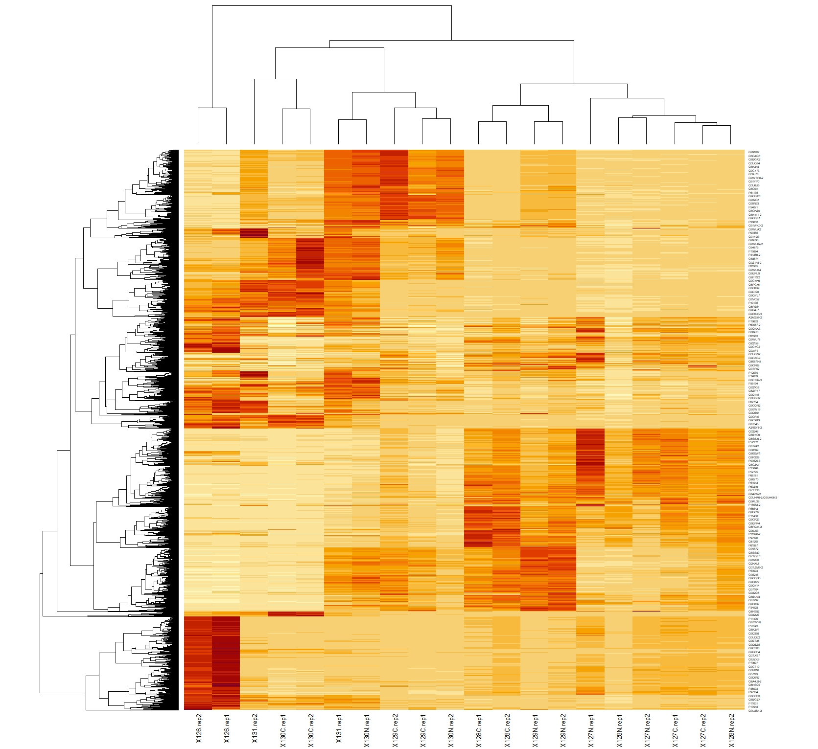
Differential Protein Abundance
Example 1
Protein/gene: Q99M07 = Coa5 [Uniprot]
Function: involved in an early step of the mitochondrial complex IV assembly process
Disease: Mitochondrial complex IV deficiency (MC4DN9; 616500) → fatal infantile cardioencephalomyopathy [OMIM]
Example 2
Protein/gene: P56480 = Atp5f1b [Uniprot]
Function: Mitochondrial membrane ATP synthase
Disease: uncoupled mitochondrial oxidative phosphorylation-2 (HUMOP2; 620085) → hypermetabolism [OMIM]
Notes:
Uniprot IDs → gene names → OMIM disease search

Slide 12
References
Al-Amrani S, Al-Jabri Z, Al-Zaabi A, Alshekaili J, Al-Khabori M. Proteomics: Concepts and applications in human medicine. World J Biol Chem. 2021 Sep 27;12(5):57-69. doi: 10.4331/wjbc.v12.i5.57. PMID: 34630910; PMCID: PMC8473418.
pRoloc:
Gatto L, Breckels LM, Wieczorek S, Burger T, Lilley KS. Mass-spectrometry-based spatial proteomics data analysis using pRoloc and pRolocdata. Bioinformatics. 2014 May 1;30(9):1322-4. doi:10.1093/bioinformatics/btu013. Epub 2014 Jan 11. PubMed PMID: 24413670; PubMed Central PMCID: PMC3998135.
Breckels LM, Gatto L, Christoforou A, Groen AJ, Lilley KS, Trotter MW. The effect of organelle discovery upon sub-cellular protein localisation. J Proteomics. 2013 Mar 21. doi:pii: S1874-3919(13)00094-8. 10.1016/j.jprot.2013.02.019. PubMed PMID: 23523639. Gatto L.,
Breckels L.M., Burger T, Nightingale D.J.H., Groen A.J., Campbell C., Mulvey C.M., Christoforou A., Ferro M., Lilley K.S. 'A foundation for reliable spatial proteomics data analysis' Mol Cell Proteomics. 2014 May 20.
Breckels LM, Holden SB, Wojnar D, Mulvey CM, Christoforou A, Groen A, Trotter MW Kohlbacher O, Lilley KS, Gatto L. Learning from Heterogeneous Data Sources: An Application in Spatial Proteomics. PLoS Comput Biol. 2016 May 13;12(5):e1004920. doi: 10.1371/journal.pcbi.1004920.
Breckels LM, Mulvey CM, Lilley KS and Gatto L. A Bioconductor workflow for processing and analysing spatial proteomics data. [version 2; peer review: 2 approved]. F1000Research 2018, 5:2926 (https://doi.org/10.12688/f1000research.10411.2)
Crook OM, Breckels LM, Lilley KS, Kirk PWD, Gatto L. A Bioconductor workflow for the Bayesian analysis of spatial proteomics [version 1; peer review: awaiting peer review]. F1000Research 2019, 8:446 (https://doi.org/10.12688/f1000research.18636.1)
MSnbase:
Laurent Gatto and Kathryn S. Lilley. MSnbase - an R/Bioconductor package for isobaric tagged mass spectrometry data visualization, processing and quantitation. Bioinformatics 28, 288-289 (2012).
Laurent Gatto, Sebastien Gibb and Johannes Rainer. MSnbase, efficient and elegant R-based processing and visualisation of raw mass spectrometry data. bioRxiv 2020.04.29.067868; doi: https://doi.org/10.1101/2020.04.29.067868 (2020).

